Slide 1

EXCEL PROJECT
SALES & FINANCE
REPORT

Slide 2
INTRODUCTION
AtliQ Hardware is a leading company that supplies products such as computer hardware and peripherals to customers like Croma, BESTBUY, Amazon etc. through them to the end consumer across the world.

Slide 3
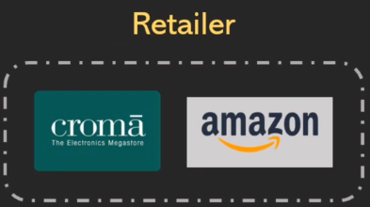


CHANNELS
Different client and channels used by AtliQ Hardware.

Slide 4
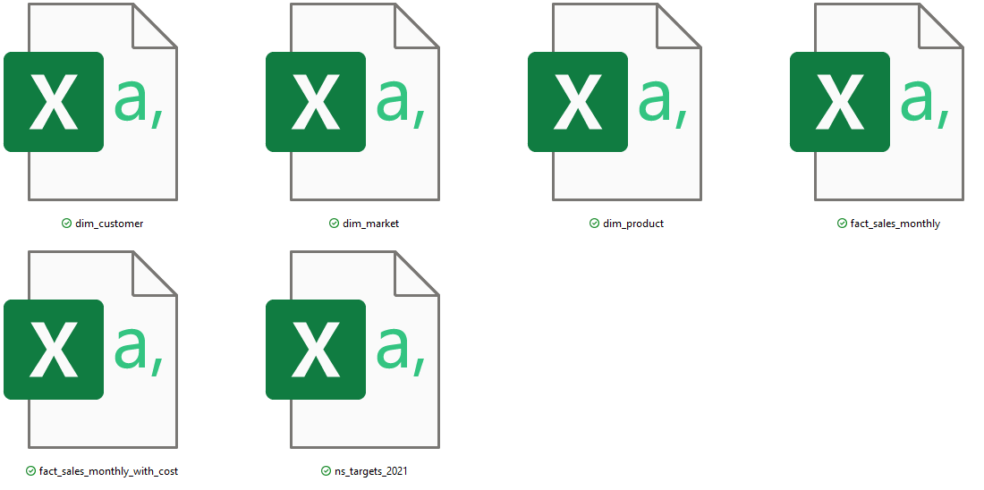
DATA SOURCE & TOOLS
• POWER QUERY
• POWER PIVOT
• PIVOT TABLE
• DAX MEASURE & COLUMNS
• CONDITION FORMATTING

Slide 5
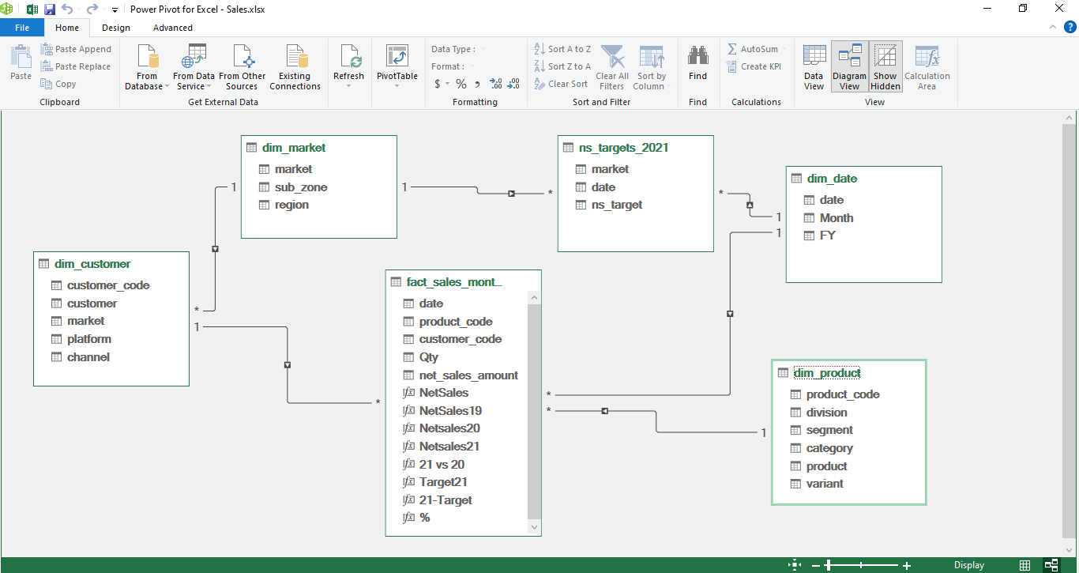
DATA MODELING

Slide 6
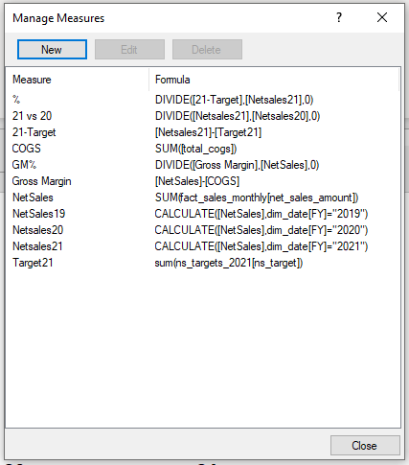
DAX MEASURES

Slide 7
SALES ANALYSIS
• Customer Performance Report
• Market Performance vs Target
• Division Level
• Top 5 Countries
• Top & Bottom Products

Slide 8
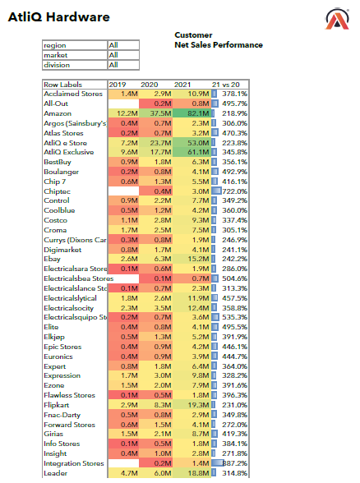
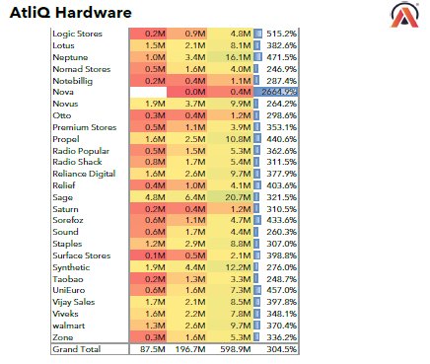
CUSTOMER NET SALES PERFORMANCE

Slide 9
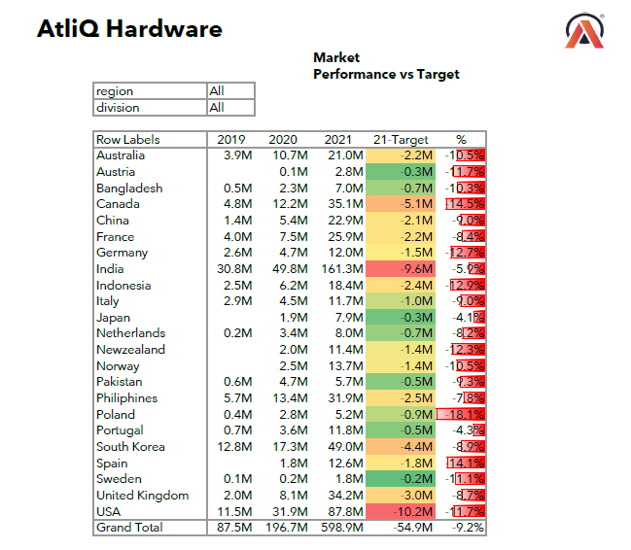
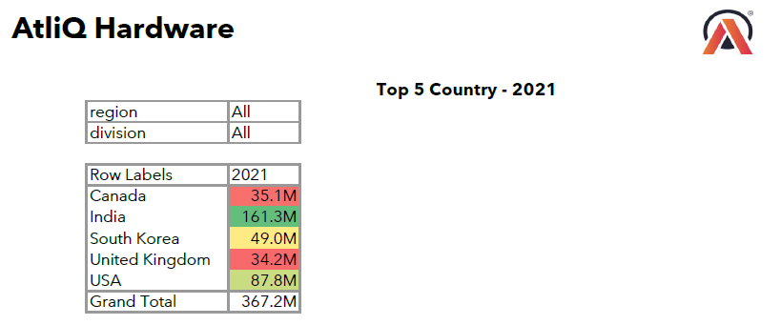
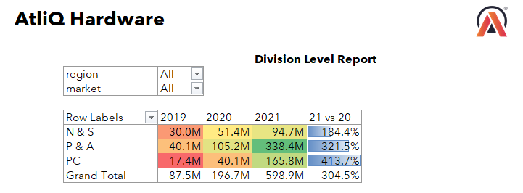
MARKET PERFORMANCE || TOP 5 COUNTRY || DIVISION LEVEL REPORT

Slide 10
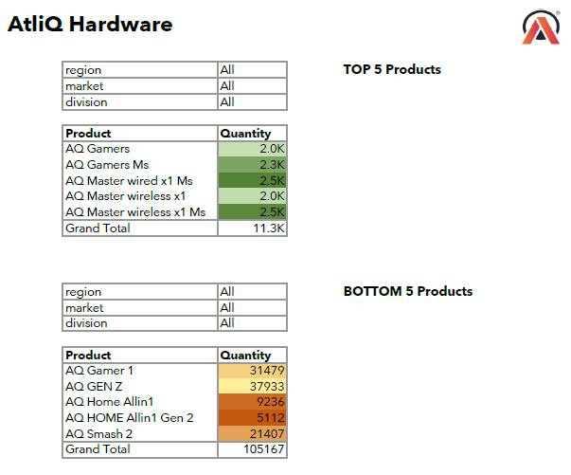
TOP & BOTTOM 5 PRODUCTS

Slide 11
FINANCE ANALYSIS
• P&L YEARLY
• P&L MONTHLY
• GM% QUARTELY

Slide 12
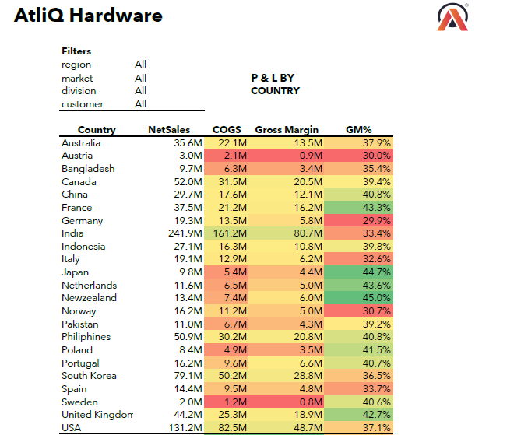
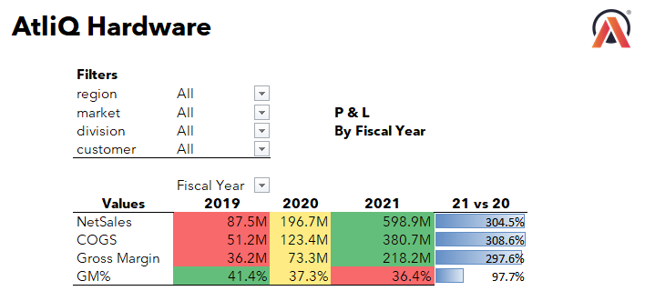
P&L BY FISCAL YEAR AND COUNTRY

Slide 13
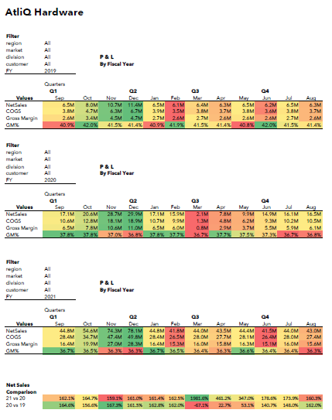
PROFIT AND LOSS REPORT MONTHLY

Slide 14
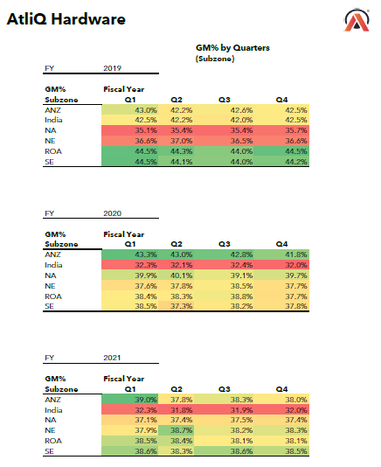
GM% BY COUNTRY

Slide 15
Thank you

